Slide 1

The Business Value of Reinforcement Learning & Causal Inference
#IRLD2021
April 7th, 2021
Hanan Shteingart

Slide 2


The business need
01
02
What is it for you?
03
04
Causal Inference & RL
Offline RL has great potential, but…
Warm Start via Domain Knowledge

Slide 3



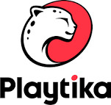
Me & RL
PhD: Model human behavior using RL
Teach RL & SL at Y-Data School (TAU)
Used RL to predict game level difficulty
Shteingart, H., Neiman, T., & Loewenstein, Y. (2013). The role of first impression in operant learning. Journal of Experimental Psychology: General, 142(2), 476.
Shteingart, H., & Loewenstein, Y. (2014). Reinforcement learning and human behavior. Current Opinion in Neurobiology, 25, 93–98.
Shteingart, H., & Loewenstein, Y. (2016). Heterogeneous suppression of sequential effects in random sequence generation, but not in operant learning. PloS One, 11(8), e0157643.
Murakami, M., Shteingart, H., Loewenstein, Y., & Mainen, Z. F. (2017). Distinct sources of deterministic and stochastic components of action timing decisions in rodent frontal cortex. Neuron, 94(4), 908–919
Roohi, S., Relas, A., Takatalo, J., Heiskanen, H., & Hämäläinen, P. (2020, November). Predicting Game Difficulty and Churn Without Players. In Proceedings of the Annual Symposium on Computer-Human Interaction in Play (pp. 585-593).

Slide 4
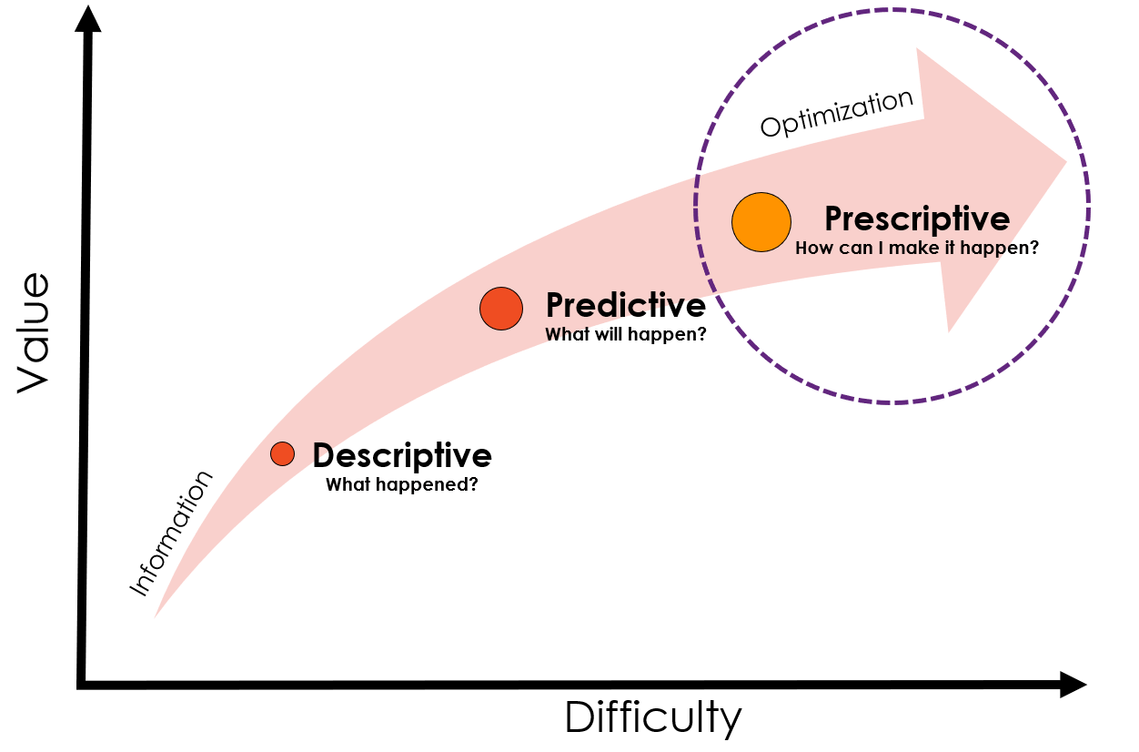


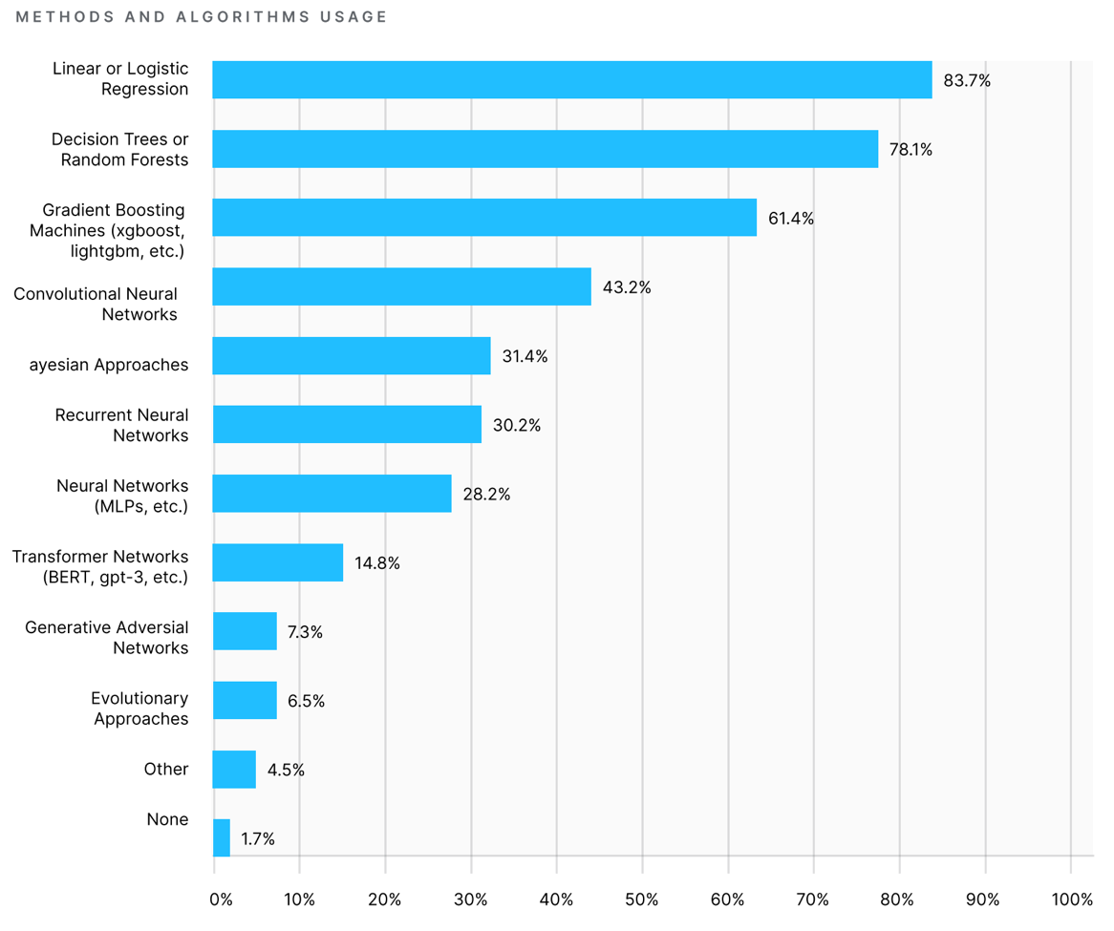
Beyond Predictions
“There is a gap between making a prediction and making a decision”
- S. Athey 2017, Science.
Prescriptive methods seem to be neglected
What is the effect of doing an action A?
What is the optimal policy π to maximize the KPI(s)?
Athey, S. (2017). Beyond prediction: Using big data for policy problems. Science, 485(February), 483–485.
Griffin, D. K. (2020). The Big Three: A Methodology to Increase Data Science ROI by Answering the Questions Companies Care About. CoRR, abs/2002.0. http://arxiv.org/abs/2002.07069
Bertsimas, D., & Kallus, N. (2020). From predictive to prescriptive analytics. Management Science, 66(3), 1025–1044. https://doi.org/10.1287/mnsc.2018.3253
https://www.kaggle.com/kaggle-survey-2020

Slide 5
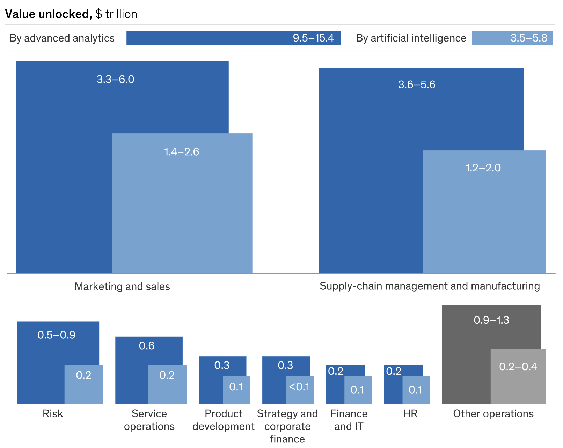

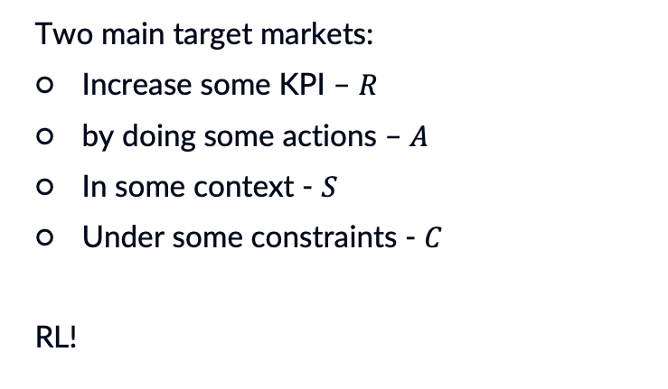
Business Opportunities for Policy Learning
Two main target markets:
Increase some KPI – $R$
by doing some actions – $A$
In some context - $S$
Under some constraints - $C$
RL!
https://www.mckinsey.com/business-functions/mckinsey-analytics/our-insights/most-of-ais-business-uses-will-be-in-two-areas

Slide 6

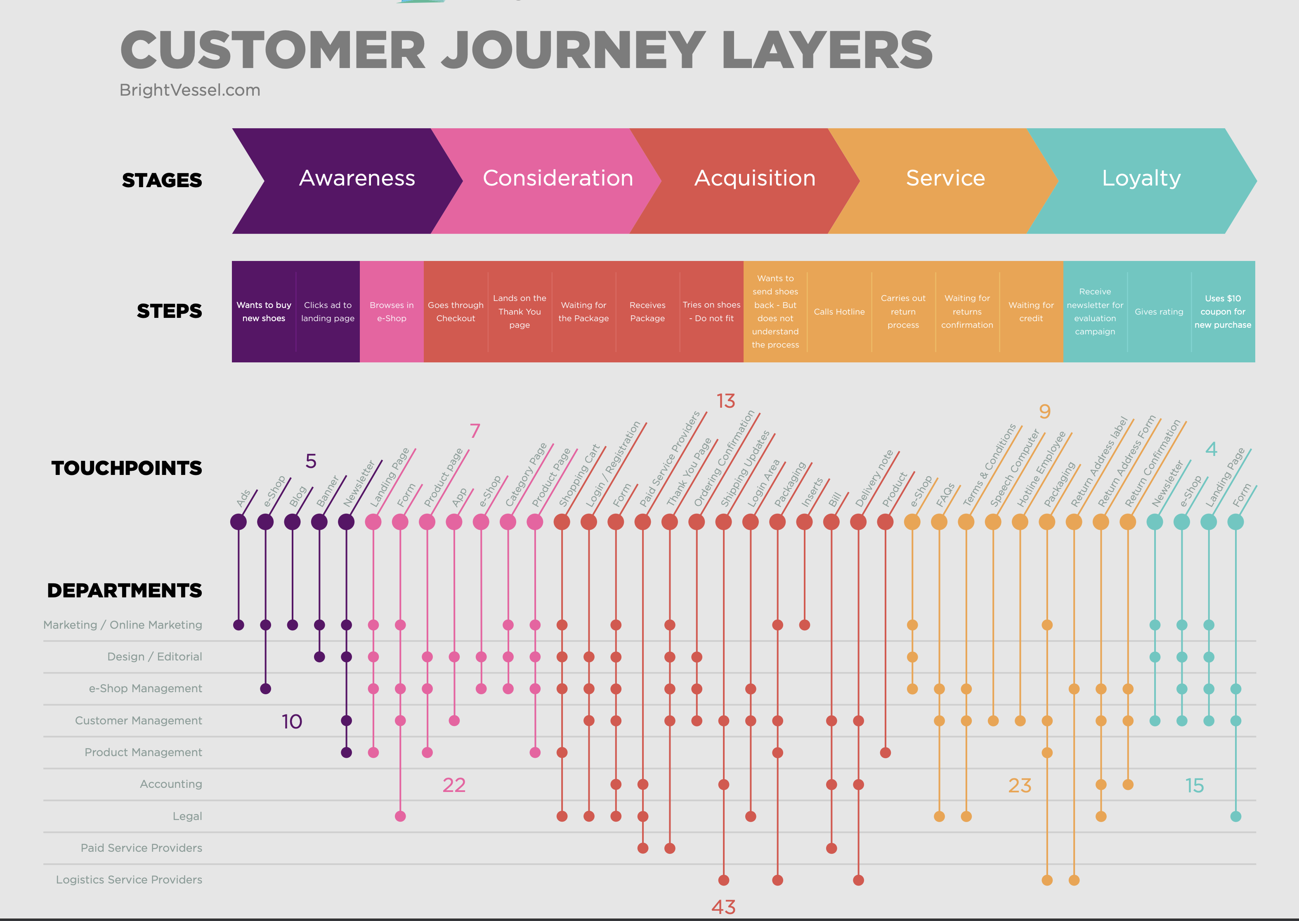


Example: Customer Journey Optimization
https://www.brightvessel.com/customer-journey-map-2018/

Slide 7




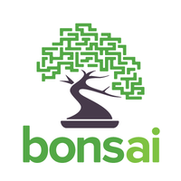
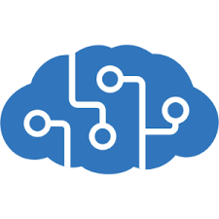
Prescriptive Resources
Simulations
Experimentation
– e.g., Bandits
Observational Data? (Offline)

Slide 8
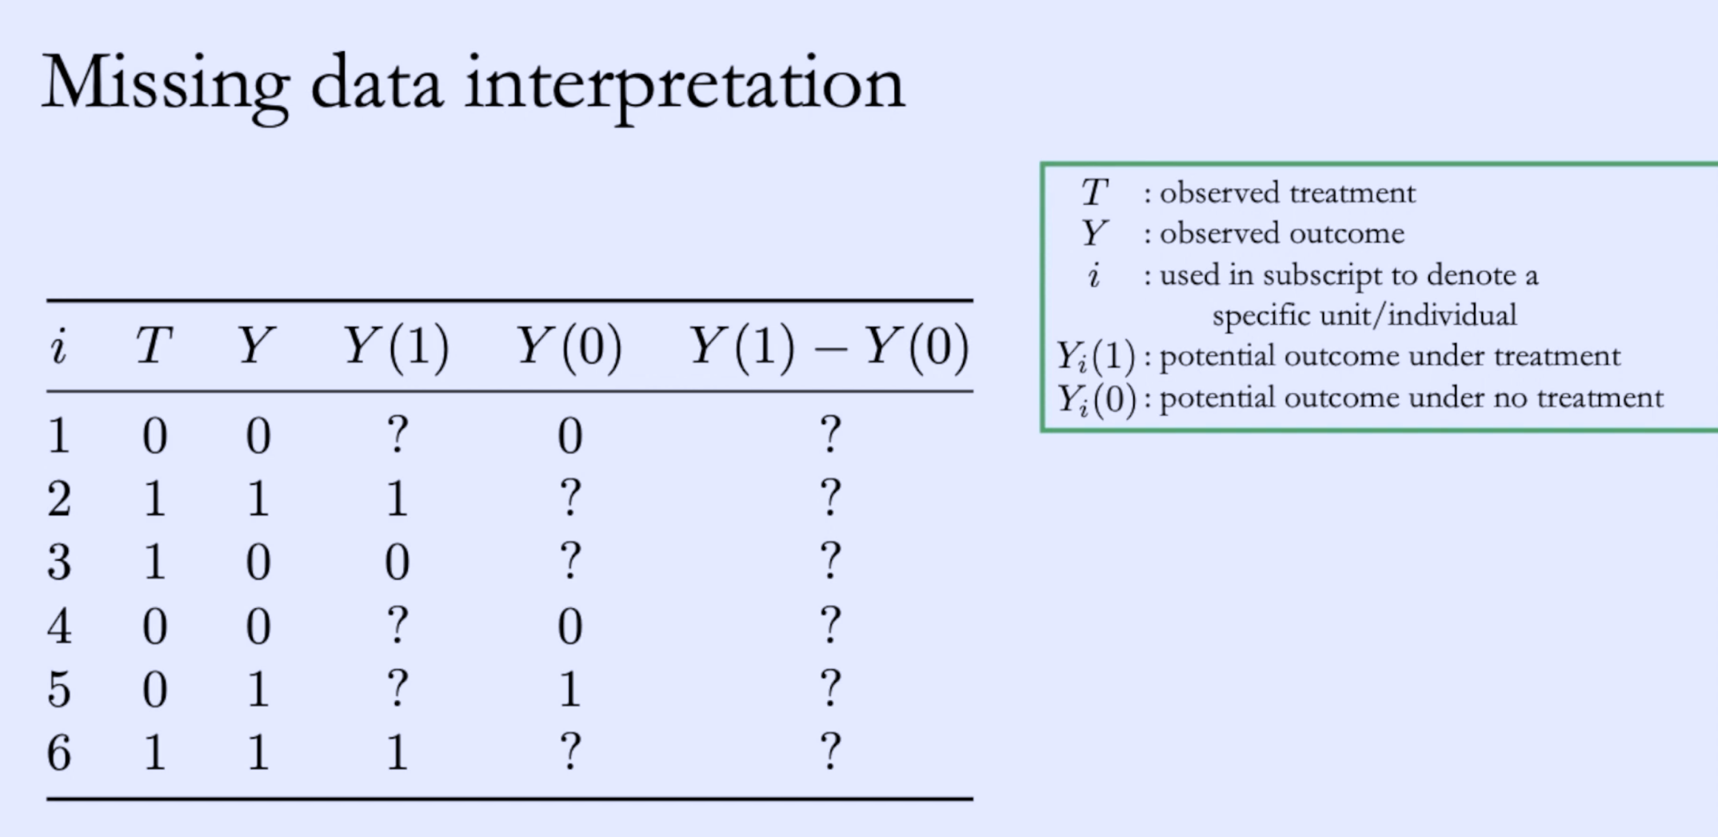
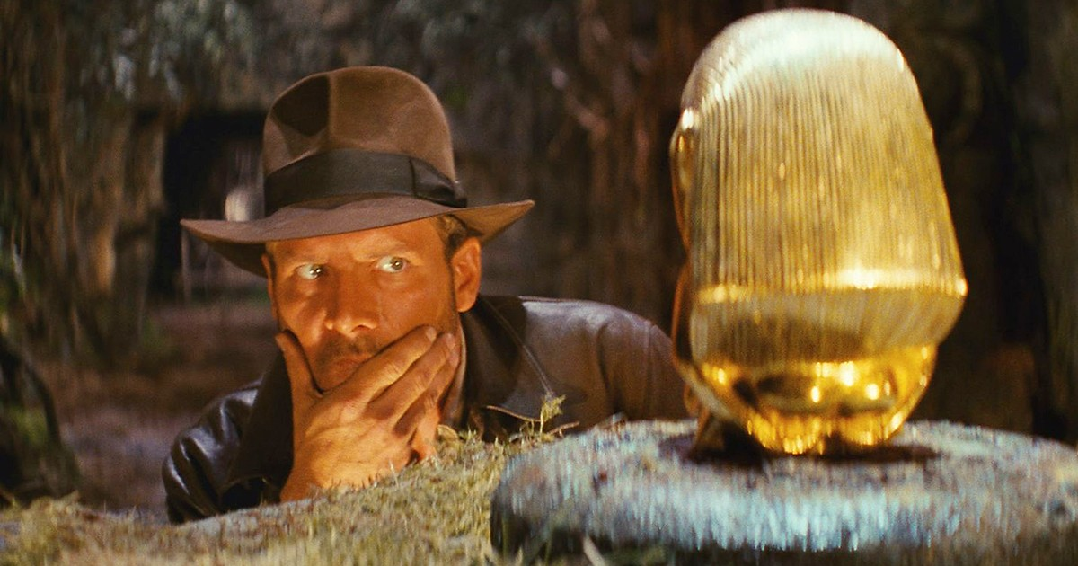
Causal Inference 101: Potential Outcomes
Fundamental problem of causal inference:
“we do not observe both potential outcomes; we only observe one”
https://www.bradyneal.com/causal-inference-course

Slide 9

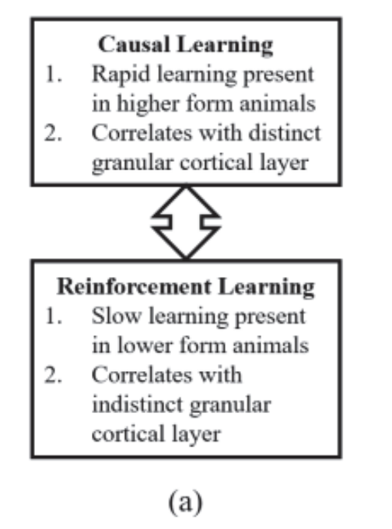
Causal Inference & RL
“These two disciplines have evolved independently … However, they are umbilically tied … This suggests the great potential for the study of causality and reinforcement learning side by side.”
/ Elias Bareinboim ICML2020.
What can CI provide RL? Better estimation and effects from offline data
Embed domain knowledge as causal assumptions
Positivity, exchangeability, confounding etc.
Towards Causal Reinforcement Learning (CRL) ICML2020 https://crl.causalai.net/
Guo, R., Cheng, L. U., Hahn, P. R., Liu, H., Cheng, L., & Li, J. (2020). A Survey of Learning Causality with Data: Problems and Methods. https://doi.org/10.1145/3397269
Yao, L., Chu, Z., Li, S., Li, Y., Gao, J., & Zhang, A. (2020). A Survey on Causal Inference. http://arxiv.org/abs/2002.02770
https://finale.seas.harvard.edu/files/finale/files/guidelines_for_reinforcement_learning_in_healthcare.pdf
Ho, S. B. (2017). Causal learning versus reinforcement learning for knowledge learning and problem solving. AAAI.

Slide 10

Example: Causal Bandits
“Combines multi-arm bandits and causal inference … so that regret is strictly better than algorithms that do not use the additional causal information” / lattimore et a, 2016
“Causal bandit …. leads to orders of magnitude faster convergence rates when compared with its causal-insensitive counterparts” / lee & bareinboim, 2018
Lattimore, F., Lattimore, T., & Reid, M. D. (2016). Causal bandits: Learning good interventions via causal inference. Advances in Neural Information Processing Systems.
Lee, S., & Bareinboim, E. (2018). Structural causal bandits: Where to intervene? Advances in Neural Information Processing Systems, 2018-Decem(NeurIPS), 2568–2578.

Slide 11
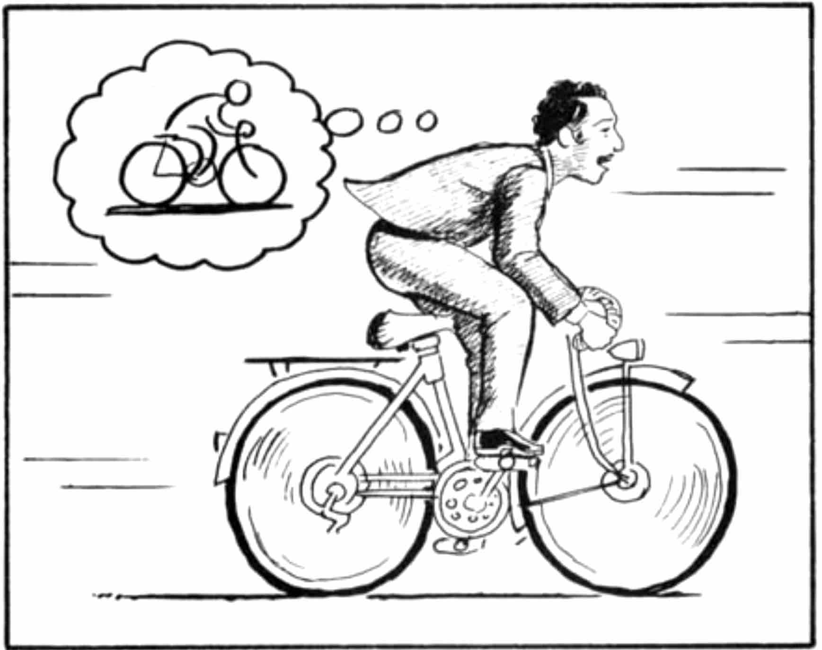
Offline RL – Great but …
The great promise
“﻿Offline reinforcement learning algorithms hold tremendous promise for making it possible to turn large datasets into powerful decision-making engines” / Levine et al. 2020
The great challenges
Distribution shift
Importance Sampling Variance
High barrier & no easy framework
Method | Score
Gym Leaderboard | 820+-58
Offline Model Based RL | 1092+-556
Levine, S., Kumar, A., Tucker, G., & Fu, J. (2020). Offline Reinforcement Learning: Tutorial, Review, and Perspectives on Open Problems. http://arxiv.org/abs/2005.01643
Ha, D., & Schmidhuber, J. (2018). World Models. https://doi.org/10.5281/zenodo.1207631 https://worldmodels.github.io/
Agarwal, R., Schuurmans, D., & Norouzi, M. (2019). An Optimistic Perspective on Offline Reinforcement Learning. http://arxiv.org/abs/1907.04543
Dulac-Arnold, G., Mankowitz, D., & Hester, T. (2019). Challenges of Real-World Reinforcement Learning. http://arxiv.org/abs/1904.12901

Slide 12
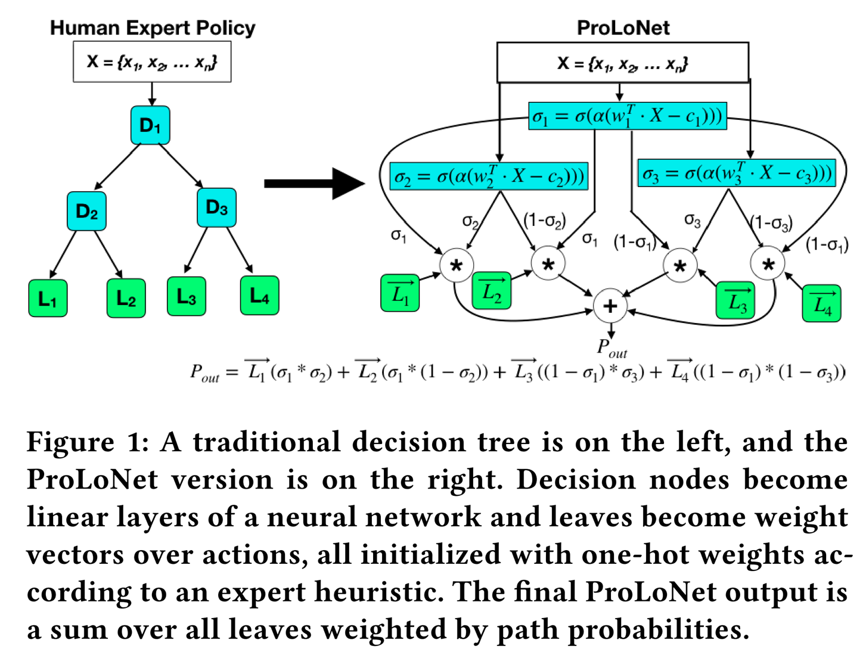
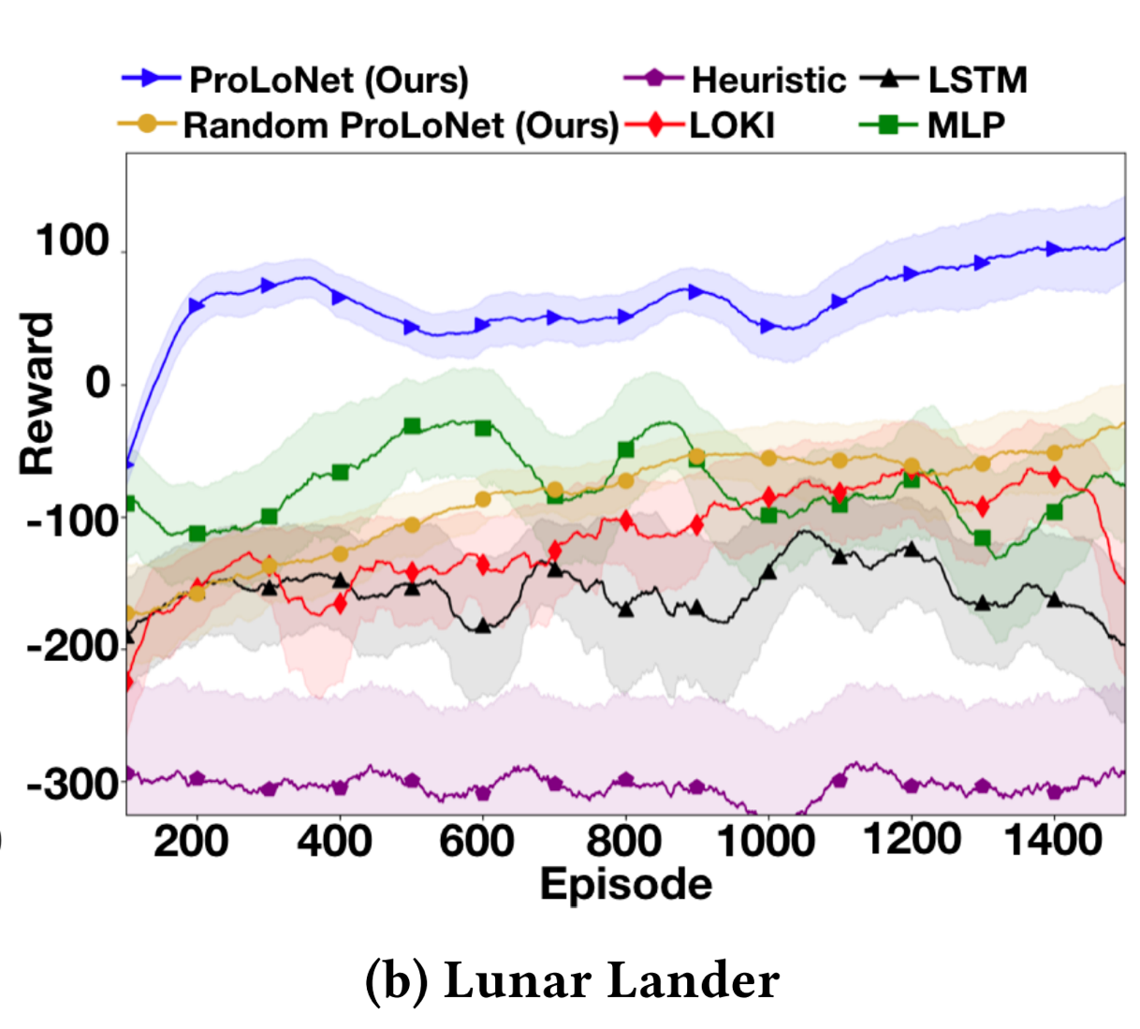

Warm Starting with Domain Knowledge
warm start RL not by offline data but via domain knowledge, e.g. a heuristic controller
Silva, A., & Gombolay, M. (2019). Neural-encoding Human Experts’ Domain Knowledge to Warm Start Reinforcement Learning. http://arxiv.org/abs/1902.06007

Slide 13



What is it for me…
VIANAI - Democratizing policy optimization for the enterprise.
We need Reaserchers, Engineers, UX, Product
Call for Academic Collaborations
We can help you to optimize your business KPIs...
hanan@vian.ai
https://machinelearning.co.il/jobs/7810/

